Slide 1


Leveraging Ticket to Work as a Revenue Source
David Hoff
Institute for Community Inclusion, UMass Boston

Slide 2
Ticket to Work:
What Is It?
For every individual ages 18-64 on:
  SSDI - Social Security Disability Insurance
  SSI - Supplementary Security Income
  -10 million individuals nationally
Mechanism to receive assistance to find employment
Goal: reduce and eliminate
reliance on cash benefits

Slide 3
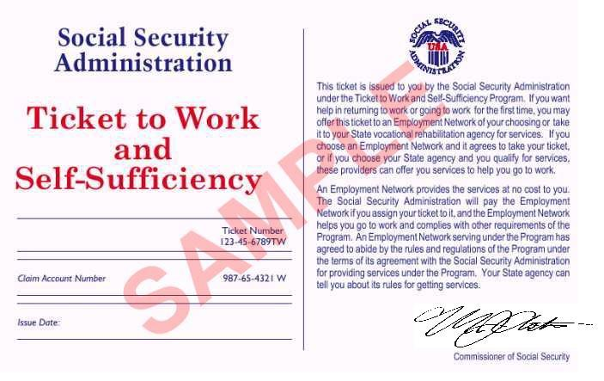
How Do Individuals Participate in Ticket?
Paper Ticket is mailed when SSDI or SSI benefits are approved
Paper Ticket is not needed to participate
Program is strictly voluntary
Beneficiary decides whether to use the Ticket and when and where to assign it.

Slide 4
Ticket to Work:
How It Works
Individual assigns Ticket to approved vendor
(Employment Network) based on mutual agreement
Signing of Individual Work Plan results in Ticket assignment
When individual becomes employed at specific earning levels, Employment
Network generates payments

Slide 6

Wage Issues
Ticket is all about gross wages earned
Wages can be from any source including multiple jobs
Employment at required wage levels does not need to be continuous

Slide 7

Ticket income is unrestricted
Ticket income can generally be combined with other resources
Monitoring and administrative requirements: relatively minimal
Linkage with benefits counseling is key
  Work Incentive Planning & Assistance (WIPA), others

Slide 8

VR
Individual cannot have Ticket assigned both to public Vocational Rehabilitation and another EN at same time
VR agencies can be paid by Social Security via Ticket or cost reimbursement
If individual is successfully placed by VR, their Ticket can be reassigned to an EN, who can receive all payments except Phase 1 ($7,616)
&

Slide 9
Service Structure
Identify Ticket holders
Engage Ticket holders to assign their Tickets
Service delivery per employment plan
Placement and wage generation
Wage verification
Follow-up for job retention

Slide 10

Ticket Assignment
& Development of Individual Work Plan
Ticket assignment occurs when
Individual Work Plan is signed
EN lets Cognosante (program manager) know that Ticket to Work has been assigned via online portal

Slide 11

Post-Placement Follow Up
Job retention is key to ongoing Ticket revenue stream
Quarterly follow-up required

Slide 12

Have in-house point person
Give ongoing attention to program
Integrate within existing services
Target and engage individuals
Link up with benefits counseling
Build program over time
Lessons
Learned

Slide 13


Questions, Comments,
Discussion

